Slide 1
Farmers’ Market Nutrition Program
Emily Mehr| S/FMNP Program Coordinator
December 2, 2020

Slide 2
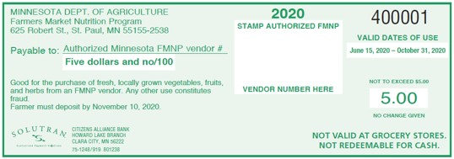
Farmers’ Market Nutrition Program
There are no changes to the Farmers’ Market Nutrition Program (FMNP) or the Senior Farmers’ Market Nutrition Program (SFMNP)
2020 S/FMNP season:
$455,000 in FMNP was redeemed at participating MN farmers’ markets
44 authorized markets
322 authorized vendors

Slide 3
Where does the program operate? (Local Agencies)
Anoka County
Beltrami County
Blue Earth County
Chisago County
Dakota County
Douglas County (Seniors Only)
Freeborn County
Hennepin County
Mower County (Seniors Only)
Olmsted County
Otter Tail County
Ramsey County
Rice County
St. Louis County (FMNP Only)
Wabasha County
Wadena County
Washington County
Notes:
Albert Lea, Austin, Mankato, Rochester, Wabasha, Northfield, Twin Cities, St Cloud, Bemidji, Fergus Falls, Wadena, Staples,

Slide 4
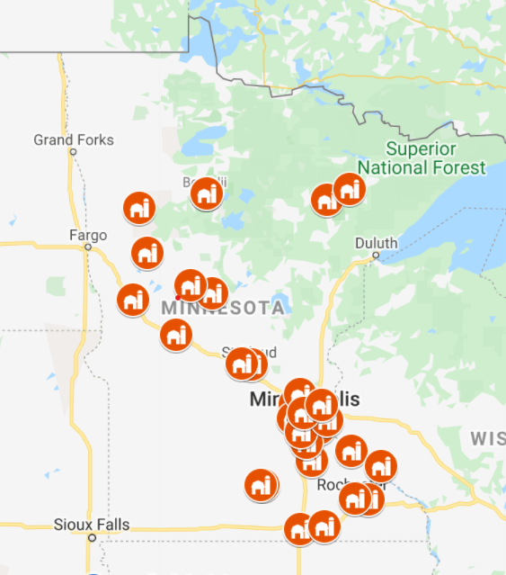
Where does the program operate? (Farmers Markets)
Metro Area
Saint Paul Farmers’ Market
Central Minnesota Vegetable
Growers’ Assoc.
Anoka County Growers’ Assoc.
Bloomington
Brooklyn Park
Champlin
Chisago City
Eagan Market Fest
Elk River
Farmers Market Annex
Hmongtown Marketplace
Hopkins
Metro Area (cont.)
Maple Grove
Midtown
Mill City
Minnetonka
Neighborhood Roots
Northeast Minneapolis
Oakdale
Richfield
Shoreview
West Broadway
White Bear
North/Central
Alexandria
Bemidji Area
Bemidji’s Natural
Fergus Falls
Hibbing
Lakes Area
St. Cloud
St. Joseph
Staples
Virginia
Wadena
White Earth
South
Albert Lea
Farmers Market Place
Eyota
Faribault
Mankato
Northfield
Red Wing
Rochester
Wabasha
Notes:
Albert Lea, Austin, Mankato, Rochester, Wabasha, Northfield, Twin Cities, St Cloud, Bemidji, Fergus Falls, Wadena, Staples,

Slide 5
More Information
MDA Toolkit at MFMA Thursday, 12/3, 12:45pm
Senior/Farmers’ Market Nutrition Program webpage https://www.mda.state.mn.us/food-feed/seniorfarmers-market-nutrition-program

Slide 6
Thank you!
Emily Mehr
emily.mehr@state.mn.us
651-201-6456
Christina Iliev
christina.iliev@state.mn.us
651-201-6494

